Slide 1

Influence of Parsimony and Work-related Psychological Constructs in Predicting Turnover Intention when Using Machine Learning VS Linear Regression
Diego Figueiras

Slide 2
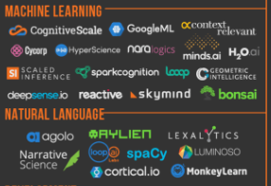
Introduction
Notes:
Give an intro to ML here. Discussion what these programs are to get caught to speed

Slide 3
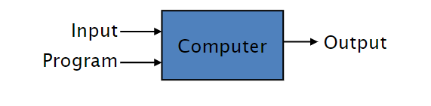
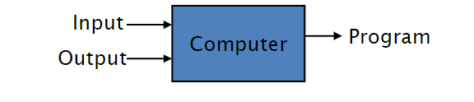
What is machine learning?
Theory-based approach
Empirical-based approach

Slide 4
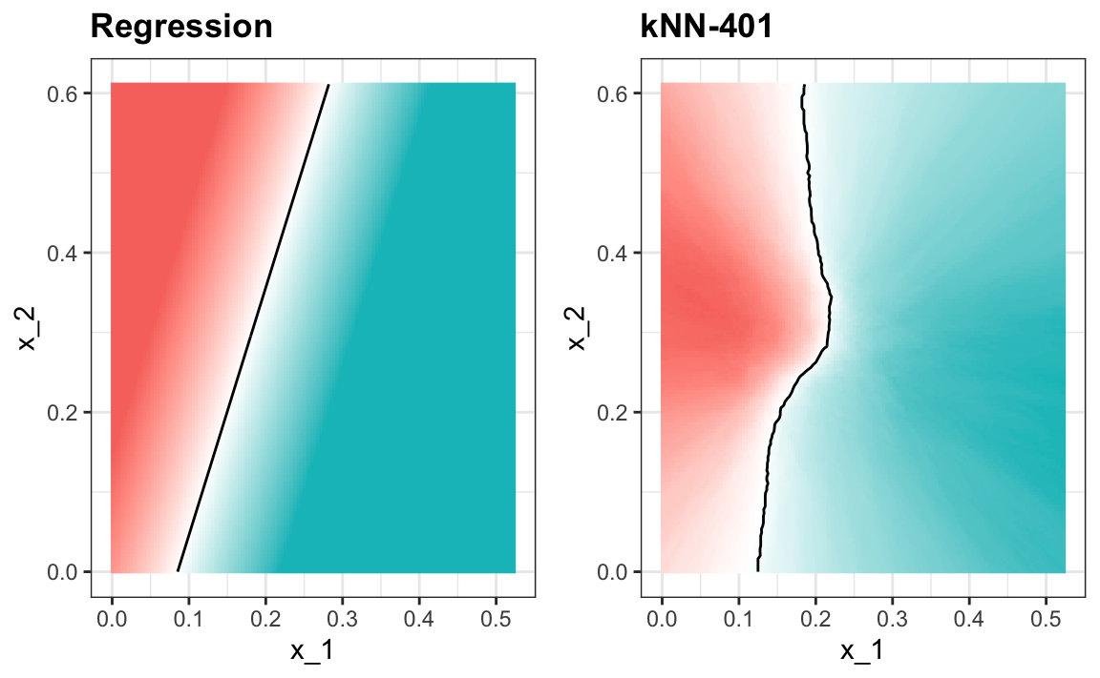
Benefits of Machine Learning

Slide 5
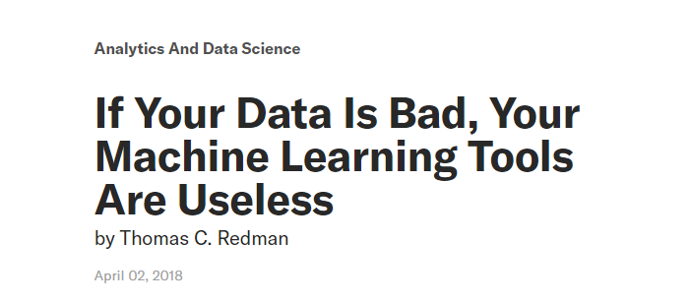

GIGO problem (garbage in, garbage out)

Slide 6
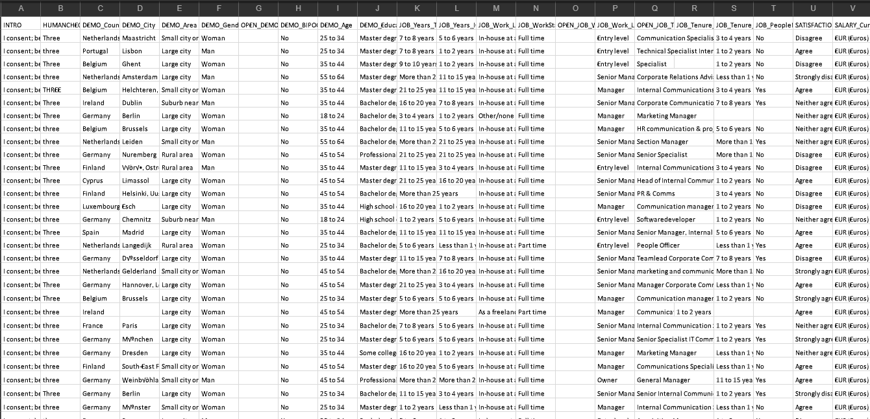
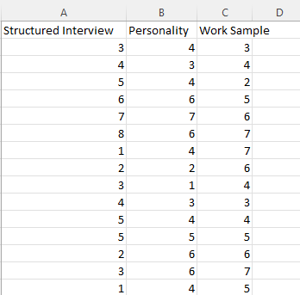
Parsimony and sparsity
Why use this...
when you can just use this?

Slide 7
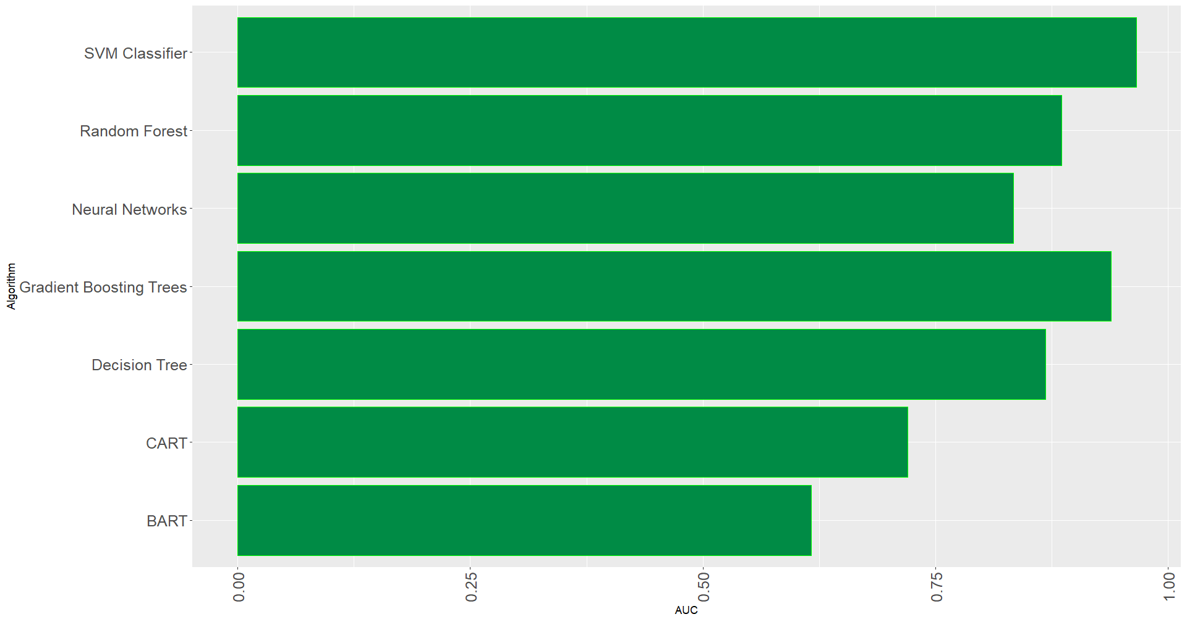
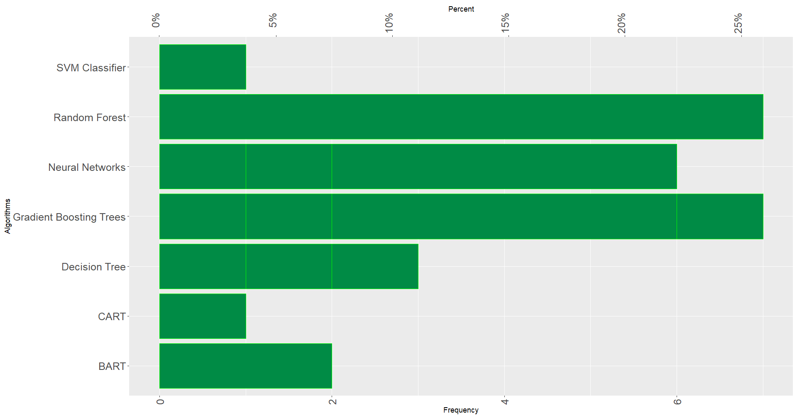
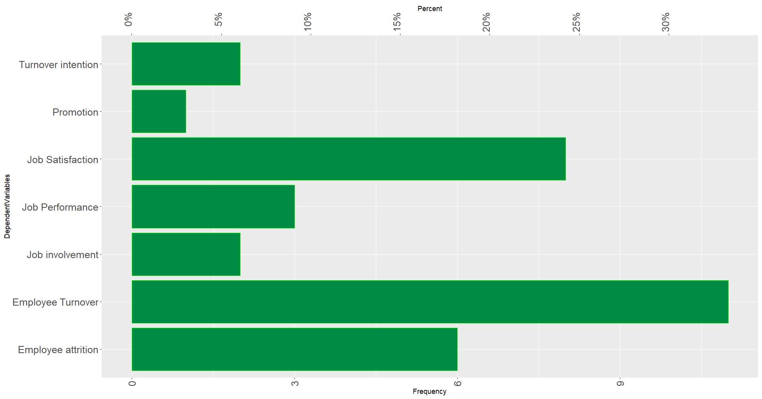
Key Findings from Prelims
GBT and SVM highest accuracies
Random Forest and GBT most common algorithms
Turnover most common DV
Notes:
Discuss here about some of the ML algorithms too

Slide 8
Conclusions
GBT producing the highest accuracy
Only two articles out of the twenty-seven reviewed had data with sample sizes above 260,000
Median events (people) per variable (EPV) was 44
Using machine learning algorithms with such small number of variables could compromise the bias-variance tradeoff, overfitting the data.

Slide 9

Hypotheses
H1
As sample size increases, the relative advantage in predictive accuracy of turnover intention between ML and regression-based algorithms will increase.
H2:
As the EPV decreases, the relative advantage in predictive accuracy of turnover intention between ML and regression-based algorithms will decrease.
H3a:
machine learning models trained with work-related psychological constructs will show better predictive accuracy metrics when predicting turnover intention than models trained using biodata.
H3b:
the predictive accuracy of machine learning models will increase when work-related psychological constructs are added to the model.

Slide 10

Data Study 1
Office of Personnel Management Federal Employee Viewpoint Survey
5 million responses
107 variables
Simulations
Survey data (to be collected)

Slide 11
Data Study 1
Job characteristics
Organizational Characteristics
Workplace environment
Turnover intention

Slide 12
Data Study 2
Qualtrics survey
Work-related psychological constructs
Biodata

Slide 13

Common ML algorithms
Decision trees
Neural networks
Support vector machines

Slide 14

Q&A

